Slide 1

IBM Project Presentation on “Ambulance Tracker”
By
Group ID: G20
Team Members Name & Enrollment No:
Anuj Jani (21162102003)
Rahul Makwana (20162171011)
Vedant Patel (20162171020)
Under the guidance of Mr. Nirav Rajgor
Institute of Computer Technology, Ganpat University
Date:

Slide 2

Problem Statement
In emergency situations, locating and dispatching ambulances promptly is a critical challenge.
Delays in ambulance arrival can lead to life-threatening consequences for patients.
Inefficiencies in the current ambulance tracking systems hinder the emergency response process.

Slide 3
Scope
The Ambulance Tracker aims to provide real-time tracking and monitoring of ambulance locations.
The system will enable efficient dispatching, reducing response times and improving patient outcomes.
The scope extends to integration with existing emergency services and hospital systems.

Slide 4

Primary Goal: Improve emergency response times by implementing a robust ambulance tracking system.
Objectives:
Real-time tracking of ambulance locations.
Integration with emergency call centers for quick dispatch.
Send alerts to hospitals when ambulances are enroute with patients
Provide accurate ETAs to hospitals and patients waiting for ambulances

Slide 5
Background
In emergency medical situations, timely arrival of ambulances is critical.
Existing systems face challenges in accurately tracking and managing ambulance fleets.
Technological advancements present an opportunity to enhance and streamline emergency response systems.

Slide 6

Feasibility Study
Market analysis shows demand from ambulance providers for tracking applications
GPS technology readily available to track vehicle locations
Ambulance providers willing to install trackers in fleet
Hospitals want real-time ETAs from ambulances
Modern mobile networks provide coverage for most regions
Opportunity to significantly improve ambulance response metrics

Slide 7

Recommended Approach
Develop a Native mobile app using Kotlin
Install GPS trackers in all ambulances to collect real-time location data
Integrate GPS modules for real-time ambulance tracking.
Implement a secure API for communication with emergency call centers.

Slide 8
Recommended Tools & Technologies
Programming Languages: JAVA
GPS Integration: Utilize device GPS capabilities.
Database : Firebase.
Mapping software - To display ambulance locations, e.g. Google Maps

Slide 9
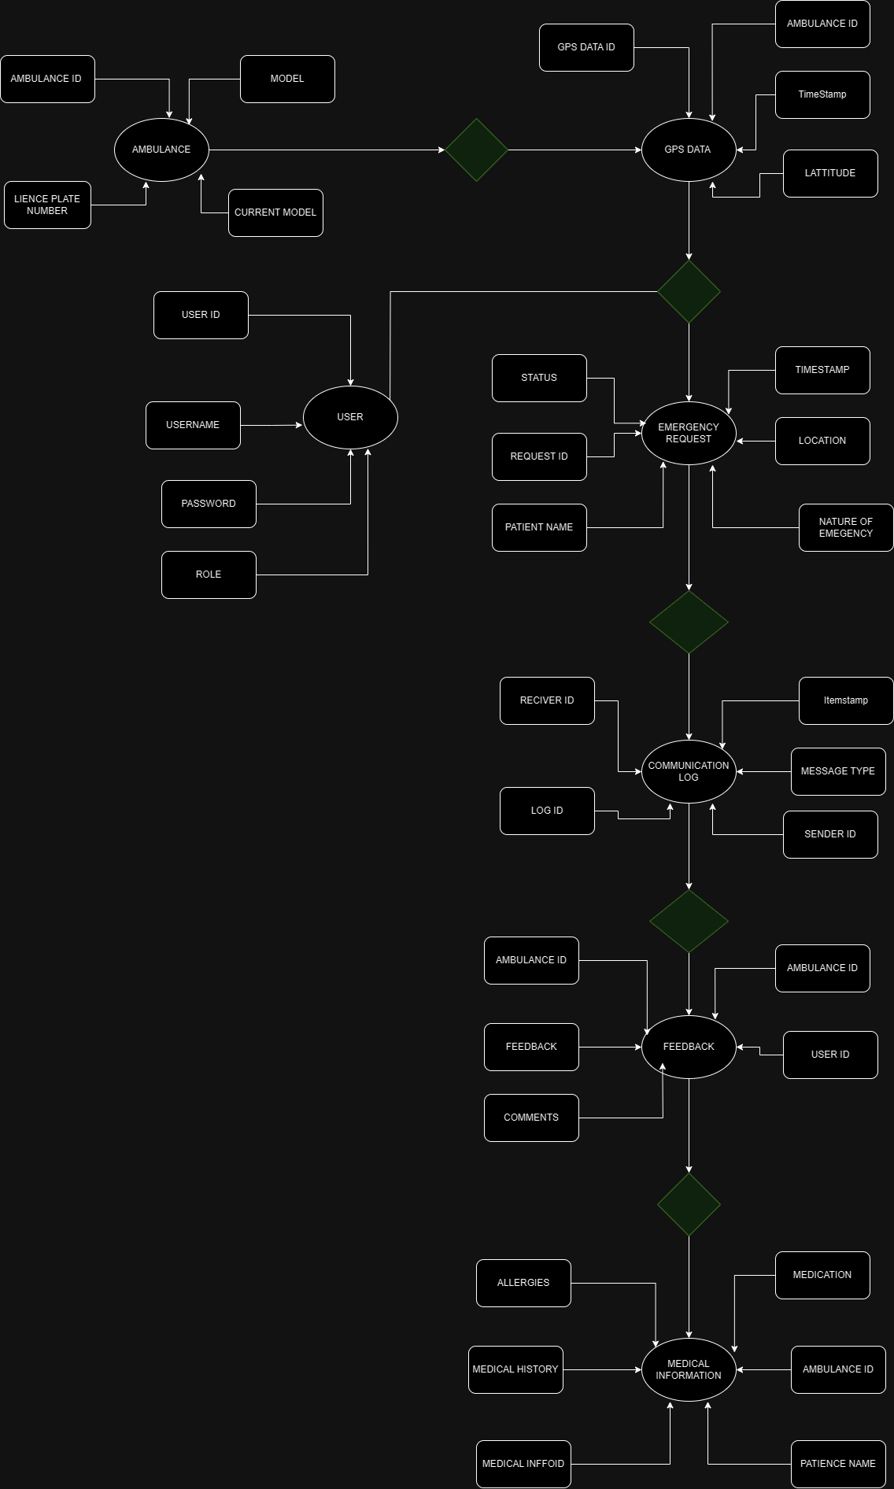
ER Diagram
Notes:
Link : https://viewer.diagrams.net/index.html?tags=%7B%7D&highlight=0000ff&edit=_blank&layers=1&nav=1&title=er%20diagram%20final#Uhttps%3A%2F%2Fdrive.google.com%2Fuc%3Fid%3D1X9A47j9Qve2laA7sLthUIMkNC2ZOo8dM%26export%3Ddownload

Slide 10
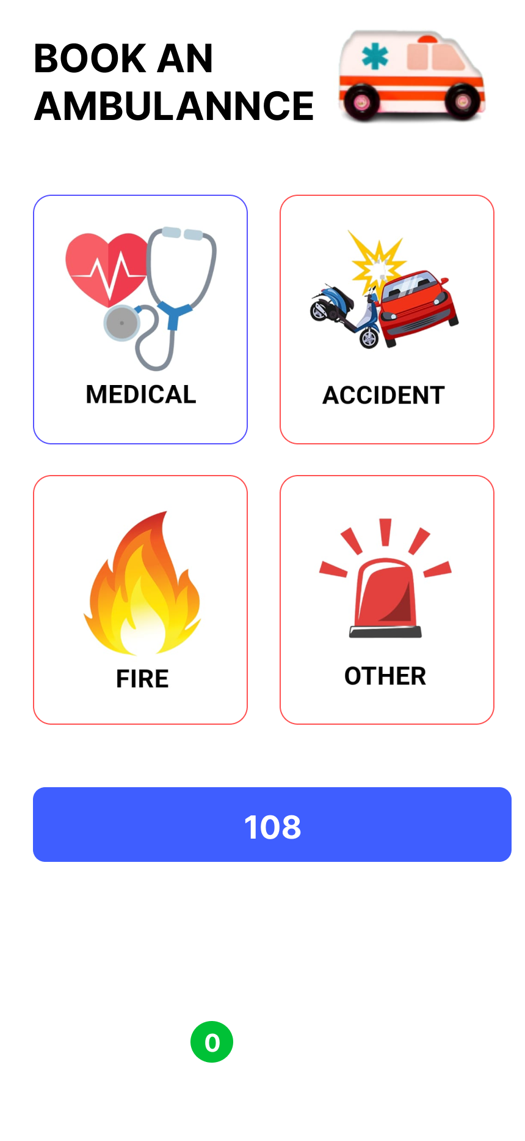
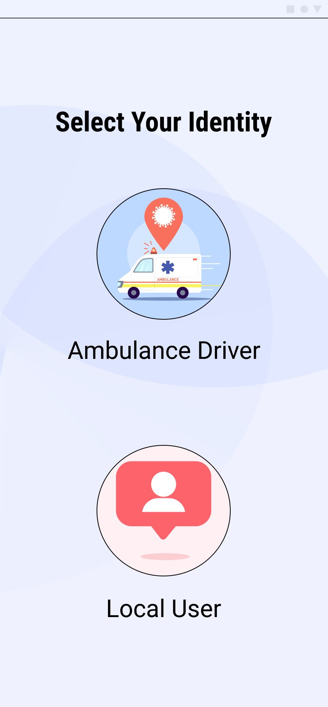
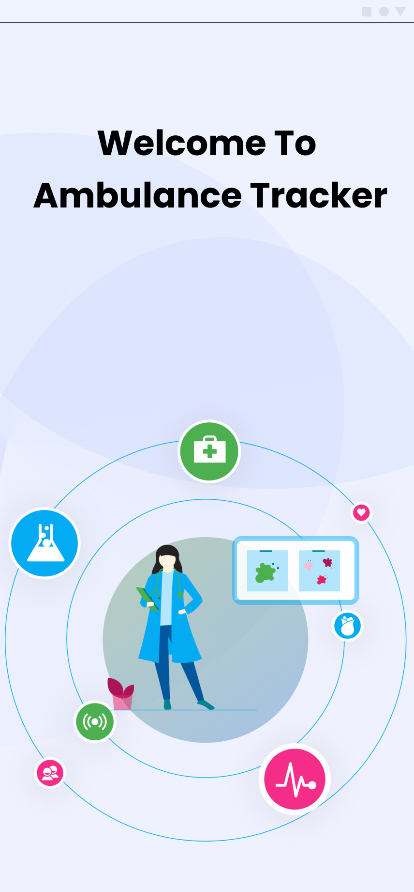
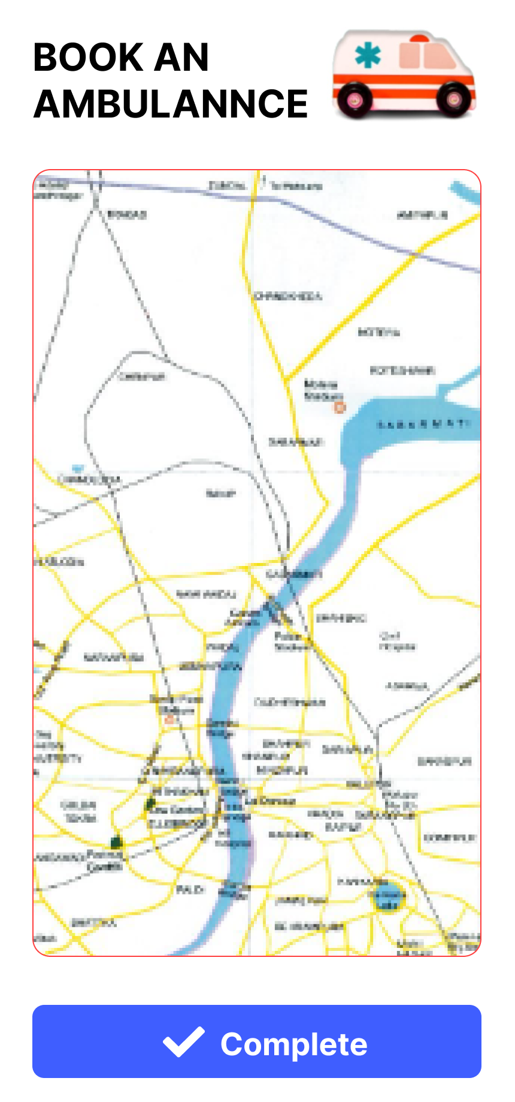
UI/UX
Notes:
Link : https://www.figma.com/file/bMeGDxl7tFWYVfmgFH3yxM/ambulance-tracker?type=design&node-id=106%3A56&mode=design&t=QX2j9loB1MuGo2P8-1

Slide 11
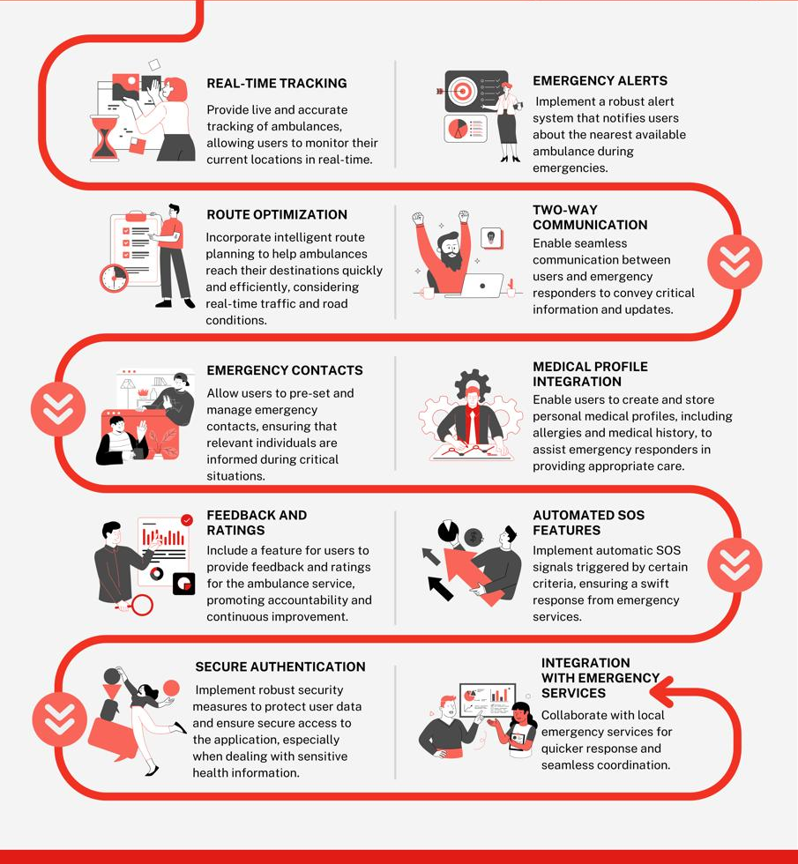
Key Features for an Ambulance Tracker Application
Notes:
Link : https://www.canva.com/design/DAF7XUZi4dM/xF1doDT3r5b42wnSuioFAQ/edit

Slide 12
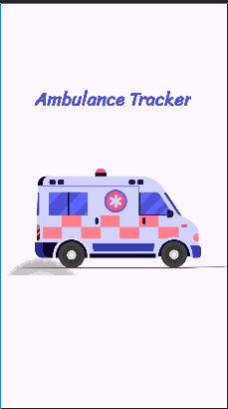
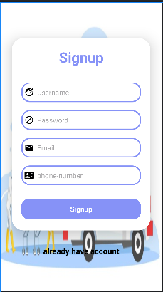
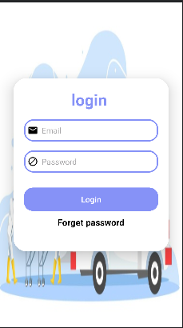
Modules

Slide 13
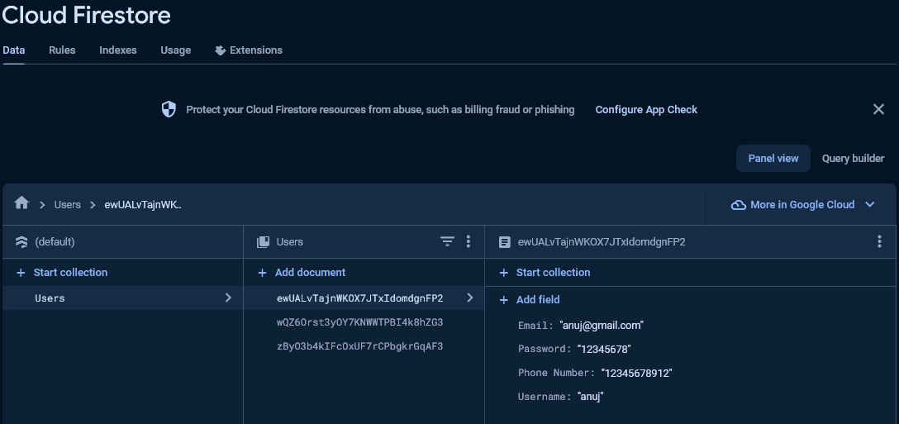
DataBase

Slide 14

Components
NodeMCU ESP8266
NEO-6M GPS Module
OLED Display Module
FP6291 Boost Converter IC
3× Resistor (10k, 100k, 48k)
6× Capacitor (2×0.1µf, 1×10µf, 2×20µf)
1× Inductor (4.7µH)
1× Diode (1N5388BRLG)
18650 Lithium Cell
18650 Cell Holder
6-Pin Push Button Switch

Slide 15
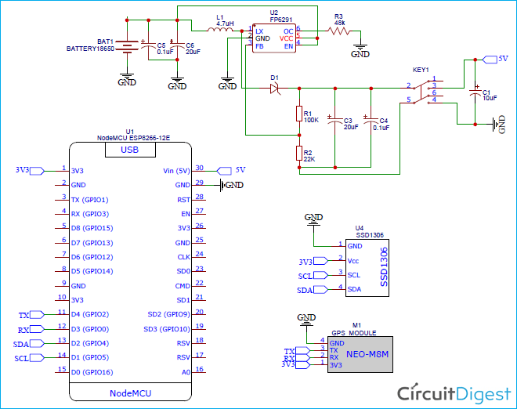
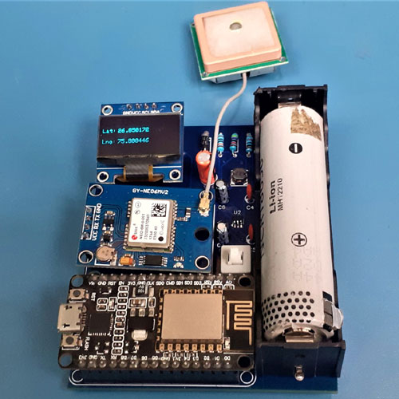
IoT Based Location

Slide 16
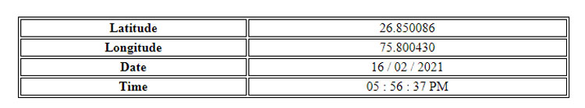
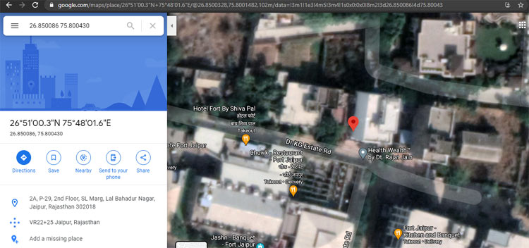
Location

Slide 17
Final Application

Slide 18
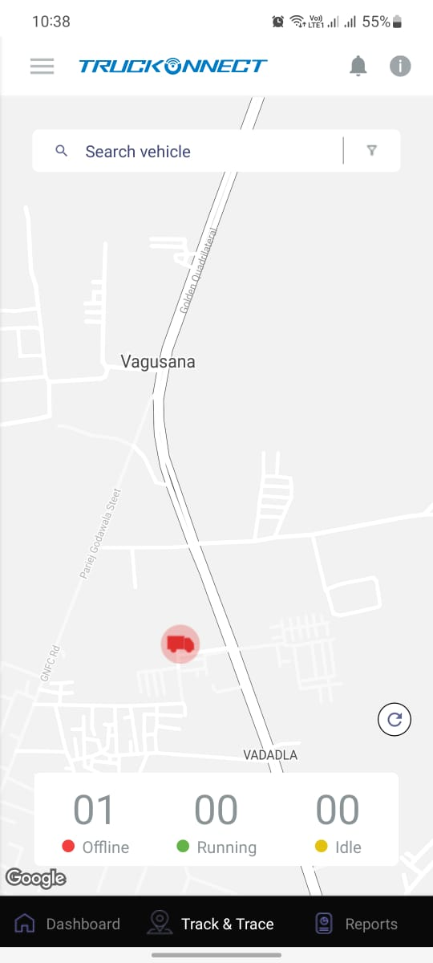
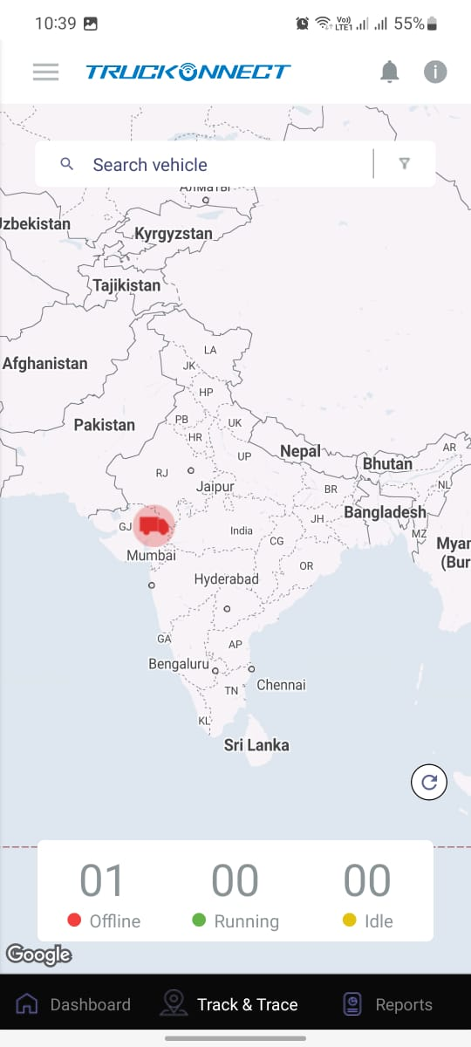
Live Location

Slide 19
Thank You

